Slide 1
Grammar
Introduction to Grammar.
Types of Grammar
Chomsky Hierarchy

Slide 2
Understanding the concept
Choose the correct sentence:-
Rahul gave Amit his favourite book.
Rahul gave his favourite book to Amit.
Rahul gave Amit his favourite book. (Correct)
Rahul gave his favourite book to Amit. (In-correct)
Rule: Subject / Verb / Indirect Object / Direct Object
Rahul / gave / Amit / his favourite book.

Slide 3
Grammar
It is a finite set of formal rules for generating syntactically correct sentences or meaningful correct sentences.
Grammar is basically composed of two basic elements –
Terminal Symbols – Terminal symbols are those which are the components of the sentences generated using a grammar and are represented using small case letter like a, b, c etc.
Non-Terminal Symbols – Non-Terminal Symbols are those symbols which take part in the generation of the sentence but are not the component of the sentence. Non-Terminal Symbols are also called Auxiliary Symbols and Variables. These symbols are represented using a capital letter like A, B, C, etc.

Slide 4
Formal Definition of Grammar
Any Grammar can be represented by 4 tuples – <N, T, P, S>
N – Finite Non-Empty Set of Non-Terminal Symbols.
T – Finite Set of Terminal Symbols.
P – Finite Non-Empty Set of Production Rules.
S – Start Symbol (Symbol from where we start producing our sentences or strings).
The start symbol is a special non-terminal symbol that serves as the initial symbol for generating the language. A derivation starts with the start symbol and applies a sequence of production rules to generate a sequence of symbols until all non-terminal symbols are replaced by terminal symbols.

Slide 5
Production Rules
A production or production rule in computer science is a rewrite rule specifying a symbol substitution that can be recursively performed to generate new symbol sequences.
It is of the form α-> β where α is a Non-Terminal Symbol which can be replaced by β which is a string of Terminal Symbols or Non-Terminal Symbols.

Slide 6
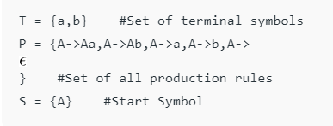
Example-1
Consider Grammar G1 = <N, T, P, S>

Slide 7
Derivation Of Strings
A->a #using production rule 3
OR
A->Aa #using production rule 1
Aa->ba #using production rule 4
OR
A->Aa #using production rule 1
Aa->AAa #using production rule 1
AAa->bAa #using production rule 4
bAa->ba #using production rule 5
As the start symbol is S then we can produce Aa, Ab, a,b, ε; which can further produce stringswhere A can be replaced by the Strings mentioned in the production rules and hence this grammar can be used to produce strings of the form (a+b)*

Slide 8
Example 2
Consider the regular grammar G = ({S, A, B}, {0, 1}, P, S) with the production rules:
S → 0A
A → 1B
B → 0A | 1B | ε
In this grammar, S is the start symbol, and the non-terminal symbols are S, A, and B. The terminal symbols are 0 and 1.

Slide 9
Derivation of Strings
Derive the string "010101“.
S → 0A
A → 1B
B → 0A
A → 1B
B → 0A
A → 1B
B → ε
S→ 0A→01B→ 010A→0101B→01010A→010101B→010101ε→010101

Slide 10
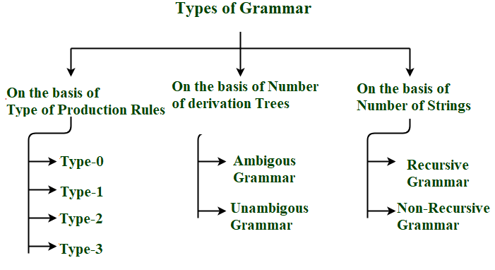
Different Types Of Grammars
Grammar can be divided on basis of –
Type of Production Rules
Number of Derivation Trees
Number of Strings
Chomsky Hierarchy

Slide 11
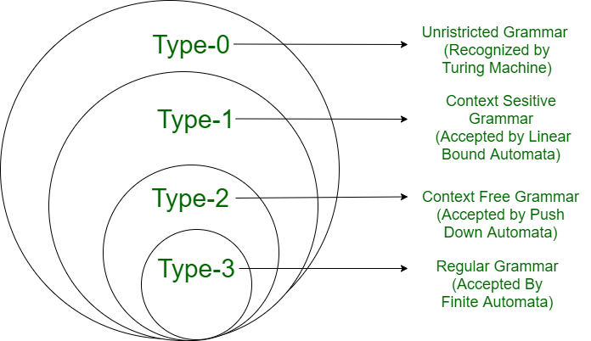
Chomsky Hierarchy
According to Chomsky hierarchy, grammar is divided into 4 types as follows:
Type 0 is known as unrestricted grammar.
Type 1 is known as context-sensitive grammar.
Type 2 is known as a context-free grammar.
Type 3 Regular Grammar.

Slide 12
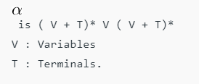

Type 0: Unrestricted Grammar
An unrestricted grammar, also known as a type-0 grammar or a phrase-structure grammar, is a formal grammar that can generate any language that can be recognized by a Turing machine. This type of grammar is the most powerful in the Chomsky hierarchy of formal grammars, which describes the class of formal languages that can be generated by different types of grammars.
Grammar Production in the form of α→β where,
S→aBb, aA→a

Slide 13
Type 1: Context-Sensitive Grammar
Type-1 grammars generate context-sensitive languages. The language generated by the grammar is recognized by the Linear Bound Automata .
The production rules in a context-sensitive grammar have the form αAβ → αγβ, where A is a non-terminal symbol, α and β are strings of terminals and non-terminals, and γ is a string of terminals and non-terminals such that |γ| >= 1.
|L.H.S.|≤ |R.H.S.|
S→AB, AB→abc, B→b.

Slide 14
Type 2: Context-Free Grammar
Type-2 grammars generate context-free languages. The language generated by the grammar is recognized by a Pushdown automata.
A production rule in a CFG is a rule of the form A → β, where A is a non-terminal and β is a string of terminals and non-terminals.
S→AB, A→a, B→b

Slide 15
Type 3: Regular Grammar
Type-3 grammars generate regular languages. These languages are exactly all languages that can be accepted by a finite-state automaton. Type 3 is the most restricted form of grammar.
Type 3 should be in the given form only
V→VT/T OR V→TV/T
S → 0A
A → 1B
B → 0A | 1B | ε

